Slide 1
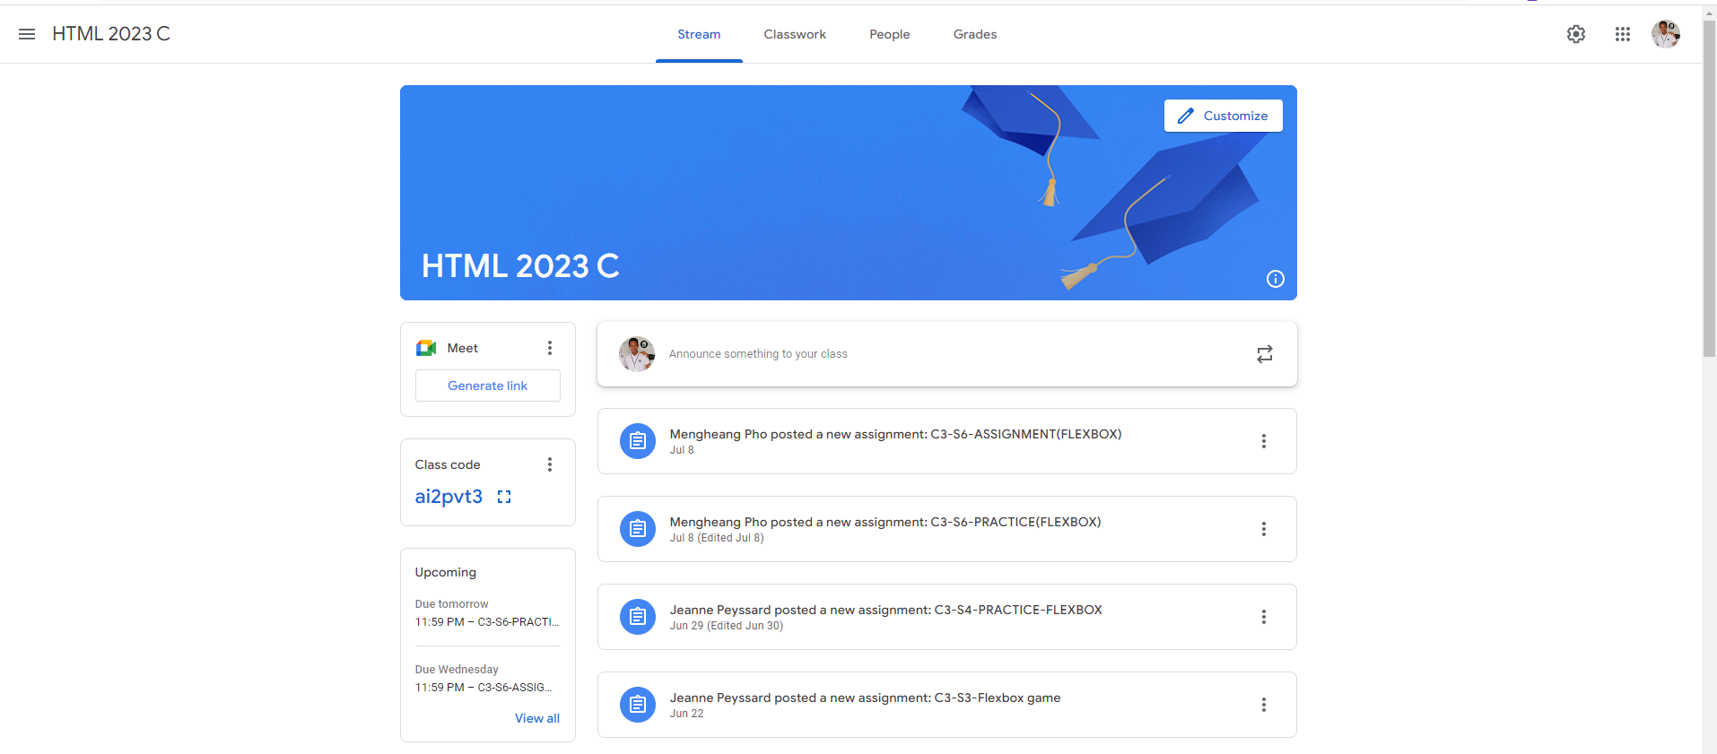
Identify root components of website below

Slide 2
Identify root components of website below
Top navigation bar that contain (Stream, Classwork, People, Grades) this provides easy access to different things.
Information Banner that shows the course name (“HTML 2023 C”) that includes a customize button to modify the banner.
Link that can be directed you to join a Google Meet session for classes.
Class Code that displays a unique class code for student to join the meeting.
Upcoming Assignment section that shows a list of upcoming deadlines for assignments, along with dues dates.
Stream Section displays recent announcements, assignment, and updates posted by teachers or instructors.
Each posts in stream section shows the author’s name and the assignment title, and there are options to expand or access additional details.
User Profile and Setting icon at the top right, they are icons for user settings and profile information.
These are the root components provide the core structure for navigating the online classroom, managing assignments, and viewing announcements.

Slide 3
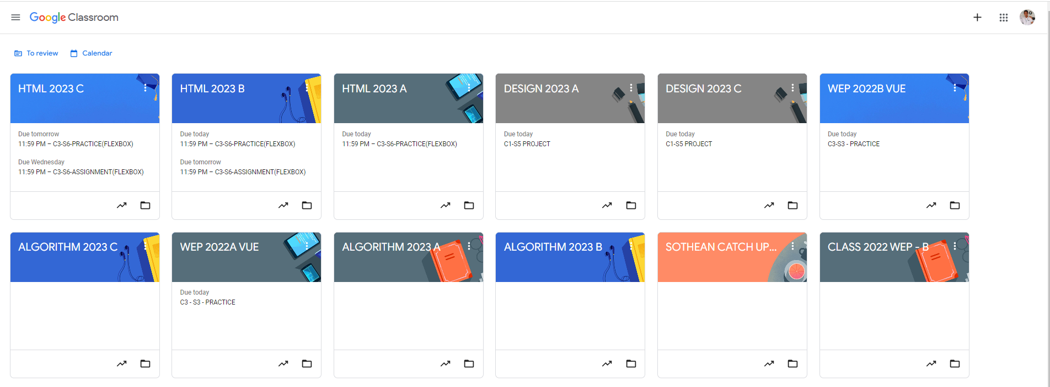
Root div
- Height: 100vh
content
nav
Flex: 0
header
Flex: 0
Flex: 1

